Slide 1

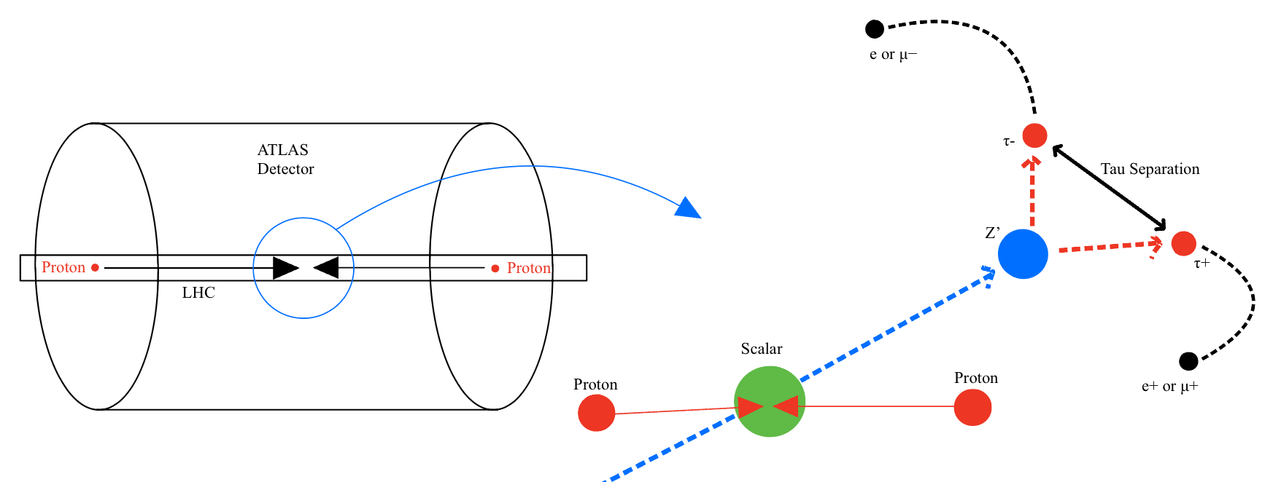
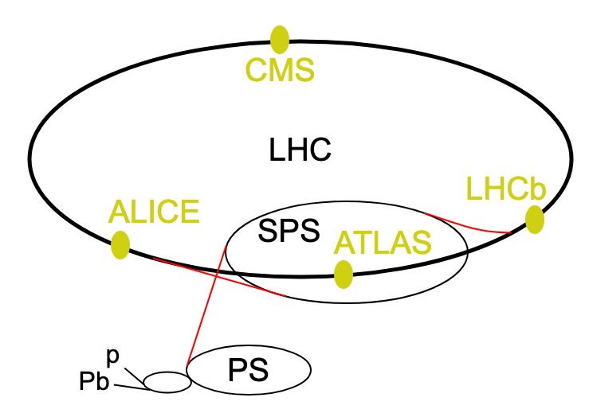
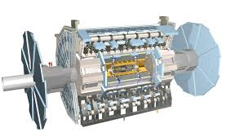
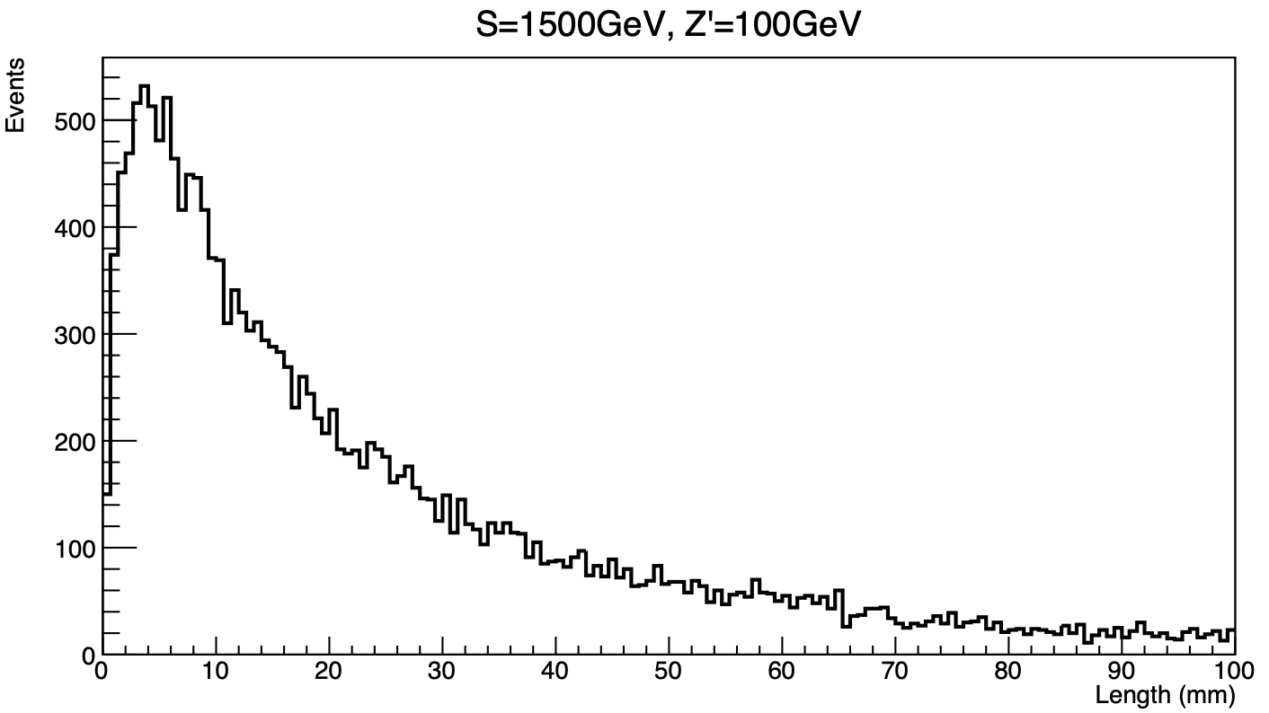
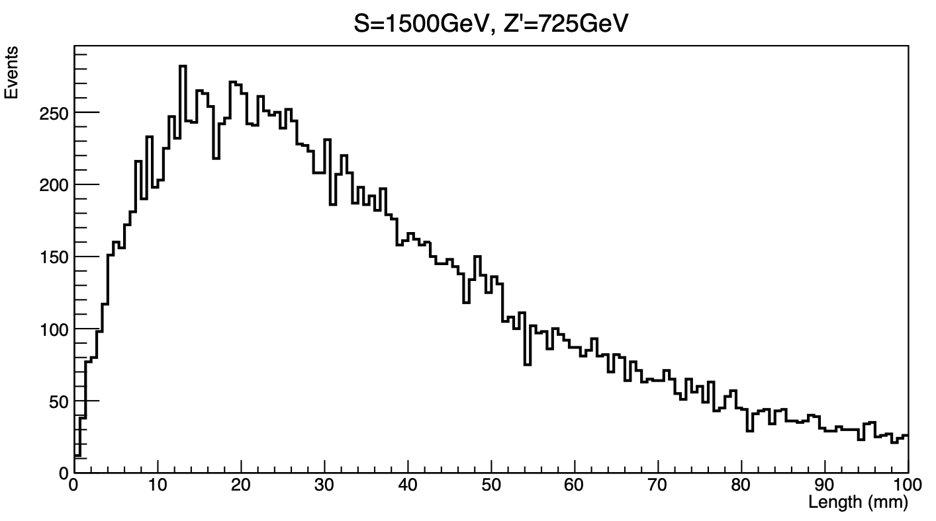
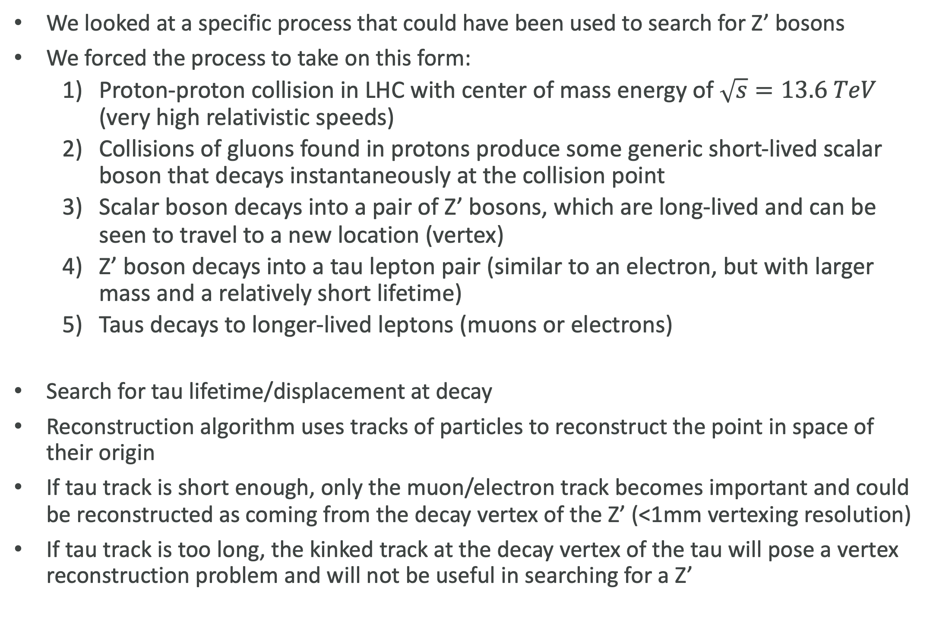
Department of Physics, The Ohio State University ATLAS Group
Search for Displaced Vertices of Tau Lepton Pairs from Z’ Decay in Proton-Proton Collisions at Truth Level with Monte Carlo Simulations
Colton DiFranco, Dr. K.K. Gan, Rachel Rosten
Background
Results
CERN, the LHC, the ATLAS Detector, and The Standard Model
In general, it seems as if there is the smallest tau separation when the difference between the scalar and Z’ masses are the greatest
Smallest average separation when S=1500 GeV & Z’=100 GeV
Largest average separation when S=1500 GeV & Z’=725 GeV
Most likely because when there is a larger mass difference, the Z’ is given a much larger boost (momentum) and therefore the daughter taus tend to be more collimated and stay closer together for longer (conservation of momentum)
This was only a trend as when the S was set to 2000 GeV and the Z’ to 100 GeV, the tau separation slightly increased
There must be more complex underlying physics at hand
CERN (The European Organization for Nuclear Physics) is located in Geneva, Switzerland, and houses the LHC (Large Hadron Collider), which is the world’s largest particle accelerator, measuring 17 miles in circumference and constructed 574 feet underground
The ATLAS detector is the LHC’s largest experiment which studies proton collisions at relativistic speeds and their resulting products
The Standard Model of particle physics is widely accepted and used to describe 3 of the 4 fundamental forces, those being the electromagnetic, strong, and weak forces. This model does not however accurately describe gravity or phenomena such as dark matter
Figure a)
50% Data <17.3mm
Efficiency Cutoff
Figure b)
50% Data <31.7mm
Efficiency Cutoff
Objectives
To determine if it is viable to use the vertexing algorithm in the ATLAS experiment in the LHC at CERN to attempt to reconstruct vertices of tau lepton pairs as decaying from a pair of Z’ bosons
Part of the larger goal of studying the possible existence of the theorized long-lived Z’ boson, which extends beyond The Standard Model of physics
Methods
Parameters
Scalar boson: This spin 0 boson is a generic short-lived boson that could take a variety of masses, so we look at this process with multiple possible mass values
Z’ boson: This is theorized to have similar traits to the Z boson (mediates the weak nuclear force) but rather be long-lived. Since this is only theorized, we do not know its specific or allowed masses, so we take a range of possibilities
11 Combinations of scalars and Z’ boson masses are tested to see how tau separation scales as a function of these two
Both charts give information on the number of events against the tau separation in 3-dimensional space. Figure a) shows the generation where the scalar mass was set to 1500GeV and the Z’ mass to 100GeV. This had the smallest separation with 50% of the tau pairs being closer than 17.3mm apart. Figure b) shows the tau separation when the scalar is set to 1500GeV and the Z’ set to 725GeV. This yielded the largest tau separation with 50% of the data being enclosed by 31.7mm.
Process
The Decay Chain and Measurements
Conclusions
We looked at a specific process that could have been used to search for Z’ bosons
We forced the process to take on this form:
Proton-proton collision in LHC with center of mass energy of $\sqrt{s}=13.6 TeV$ (very high relativistic speeds)
Collisions of gluons found in protons produce some generic short-lived scalar boson that decays instantaneously at the collision point
Scalar boson decays into a pair of Z’ bosons, which are long-lived and can be seen to travel to a new location (vertex)
Z’ boson decays into a tau lepton pair (similar to an electron, but with larger mass and a relatively short lifetime)
Taus decays to longer-lived leptons (muons or electrons)
Search for tau lifetime/displacement at decay
Reconstruction algorithm uses tracks of particles to reconstruct the point in space of their origin
If tau track is short enough, only the muon/electron track becomes important and could be reconstructed as coming from the decay vertex of the Z’ (<1mm vertexing resolution)
If tau track is too long, the kinked track at the decay vertex of the tau will pose a vertex reconstruction problem and will not be useful in searching for a Z’
Monte Carlo (MC) Simulations
Even in the sample with the smallest separation, only ~2% of the tau pairs had a separation of <1mm (~400 of 20,000 events)
This is too inefficient to justify a full, resource-intensive study with ATLAS
Unfortunately, it seems as if Z’ decay to tau pairs is not an effective means of searching for Z’
There are other means searching for Z’ such as in muon decay
Although unsuccessful in searching for a method to search for Z’ bosons, this feasibility study helped to narrow down search possibilities to help ATLAS physicists in their further research
Algorithm used to produce highly complex physical processes
Unique JobOptions file is used for each specific generation
Found existing JobOptions file of a similar process
Adjusted parameters to fit the exact decay chain and masses that we wanted to look for
Ran generations of the process with 11 combinations of scalar and Z’ masses, where each generation had 20,000 events
Generations are at truth level (does not include detector interactions, only the physical processes)
Perform TRUTH derivation on output generation file to verify that the physical processes ran as expected
Add and edit existing C++ analysis code to run on TRUTH file to obtain plots and analyze data in which we were interested in (tau separation in 3D space and transverse plane along with Z’ decay length)
Acknowledgements
Research supported and funded by the Summer Research Opportunities Program (SROP) at The Ohio State University
Research conducted at and in with collaboration with CERN and the ATLAS Experiment

